Slide 1
The three R’s… and the three S’s
1 Timothy 3:8:13

Slide 3
Do you have the qualifications?
Saint
Servant
Soldier

Slide 4
Do you have the prerequisites?
Relationship
Recognition
Recommendation

Slide 5
1 Timothy 3:8-13
8 Deacons likewise must be men of dignity, not double-tongued, or addicted to much wine or fond of sordid gain, 9 but holding to the mystery of the faith with a clear conscience. 10 These men must also first be tested; then let them serve as deacons if they are beyond reproach. 11 Women must likewise be dignified, not malicious gossips, but temperate, faithful in all things. 12 Deacons must be husbands of only one wife, and good managers of their children and their own households. 13 For those who have served well as deacons obtain for themselves a high standing and great confidence in the faith that is in Christ Jesus.

Slide 6
Acts 6:1-6
Now at this time while the disciples were increasing in number, a complaint arose on the part of the Hellenistic Jews against the native Hebrews, because their widows were being overlooked in the daily serving of food. 2 So the twelve summoned the congregation of the disciples and said, “It is not desirable for us to neglect the word of God in order to serve tables. 3 Therefore, brethren, select from among you seven men of good reputation, full of the Spirit and of wisdom, whom we may put in charge of this task. 4 But we will devote ourselves to prayer and to the ministry of the word.” 5 The statement found approval with the whole congregation; and they chose Stephen, a man full of faith and of the Holy Spirit, and Philip, Prochorus, Nicanor, Timon, Parmenas and Nicolas, a proselyte from Antioch. 6 And these they brought before the apostles; and after praying, they laid their hands on them.

Slide 7
FIRSTLY A DEACON MUST BE A SAINT
There Must Be A Relationship To The Savior
There Must Be A Recognition By The Saints
There Must Be A Recommendation By The Spirit

Slide 8
The list of requirements is DESCRIPTIVE NOT PRESCRIPTIVE

Slide 9
SECONDLY A DEACON MUST BE A SERVANT
Dignity.
Not double tongued.
Not controlled by wine or money.
Holding the mystery of the Faith with a clear conscience.
Must be tested.
Must serve.
Women/Wives/Deaconesses.
Called to serve the faithful.

Slide 10
THIRDLY A DEACON MUST BE A SOLDIER
1 Timothy 3: 9 holding to the mystery of the faith with a clear conscience.
2 Timothy 2:2 The things which you have heard from me in the presence of many witnesses, entrust these to faithful men who will be able to teach others also.

Slide 11
The Practical Conclusion
Every one of us should seek to be Saint, Servant and Soldier.
What is the root of this tree? Saint, Servant, Soldier… Recognition and Recommendation… they all grow from one root…

Slide 12
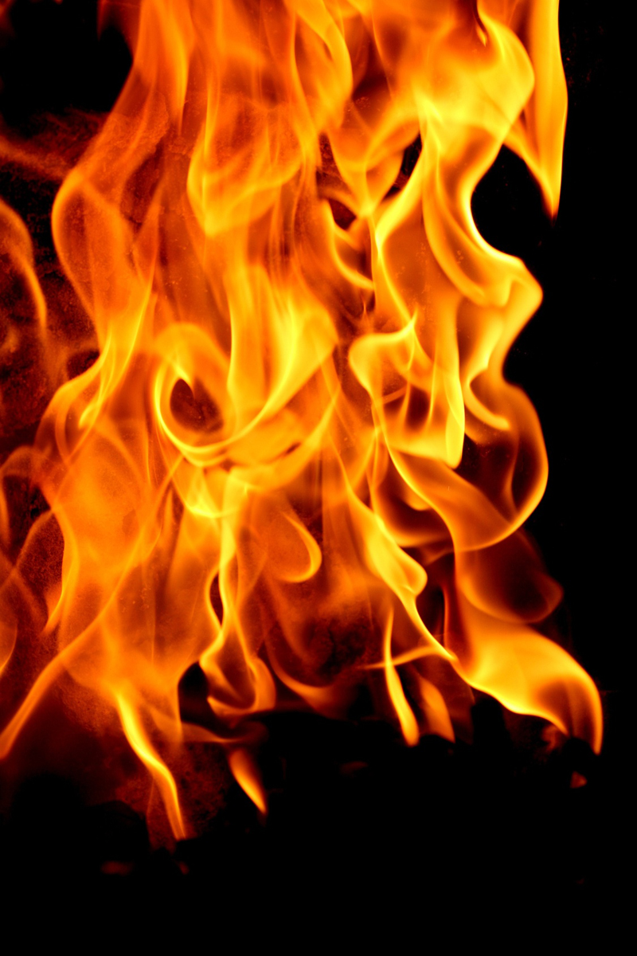
RELATIONSHIP THROUGH CHRIST BUILT IN PRAYER AND THE CONTINUAL INFILLING OF THE HOLY SPIRIT.

